Slide 1
CSS and HostGator
CIS2336

Slide 2

HostGator Account
Username
First name initial Last Name and 19S
nfofanova19s
Password
I(#1DboTKbw=
http://heyuhnem.com/cpanel

Slide 3
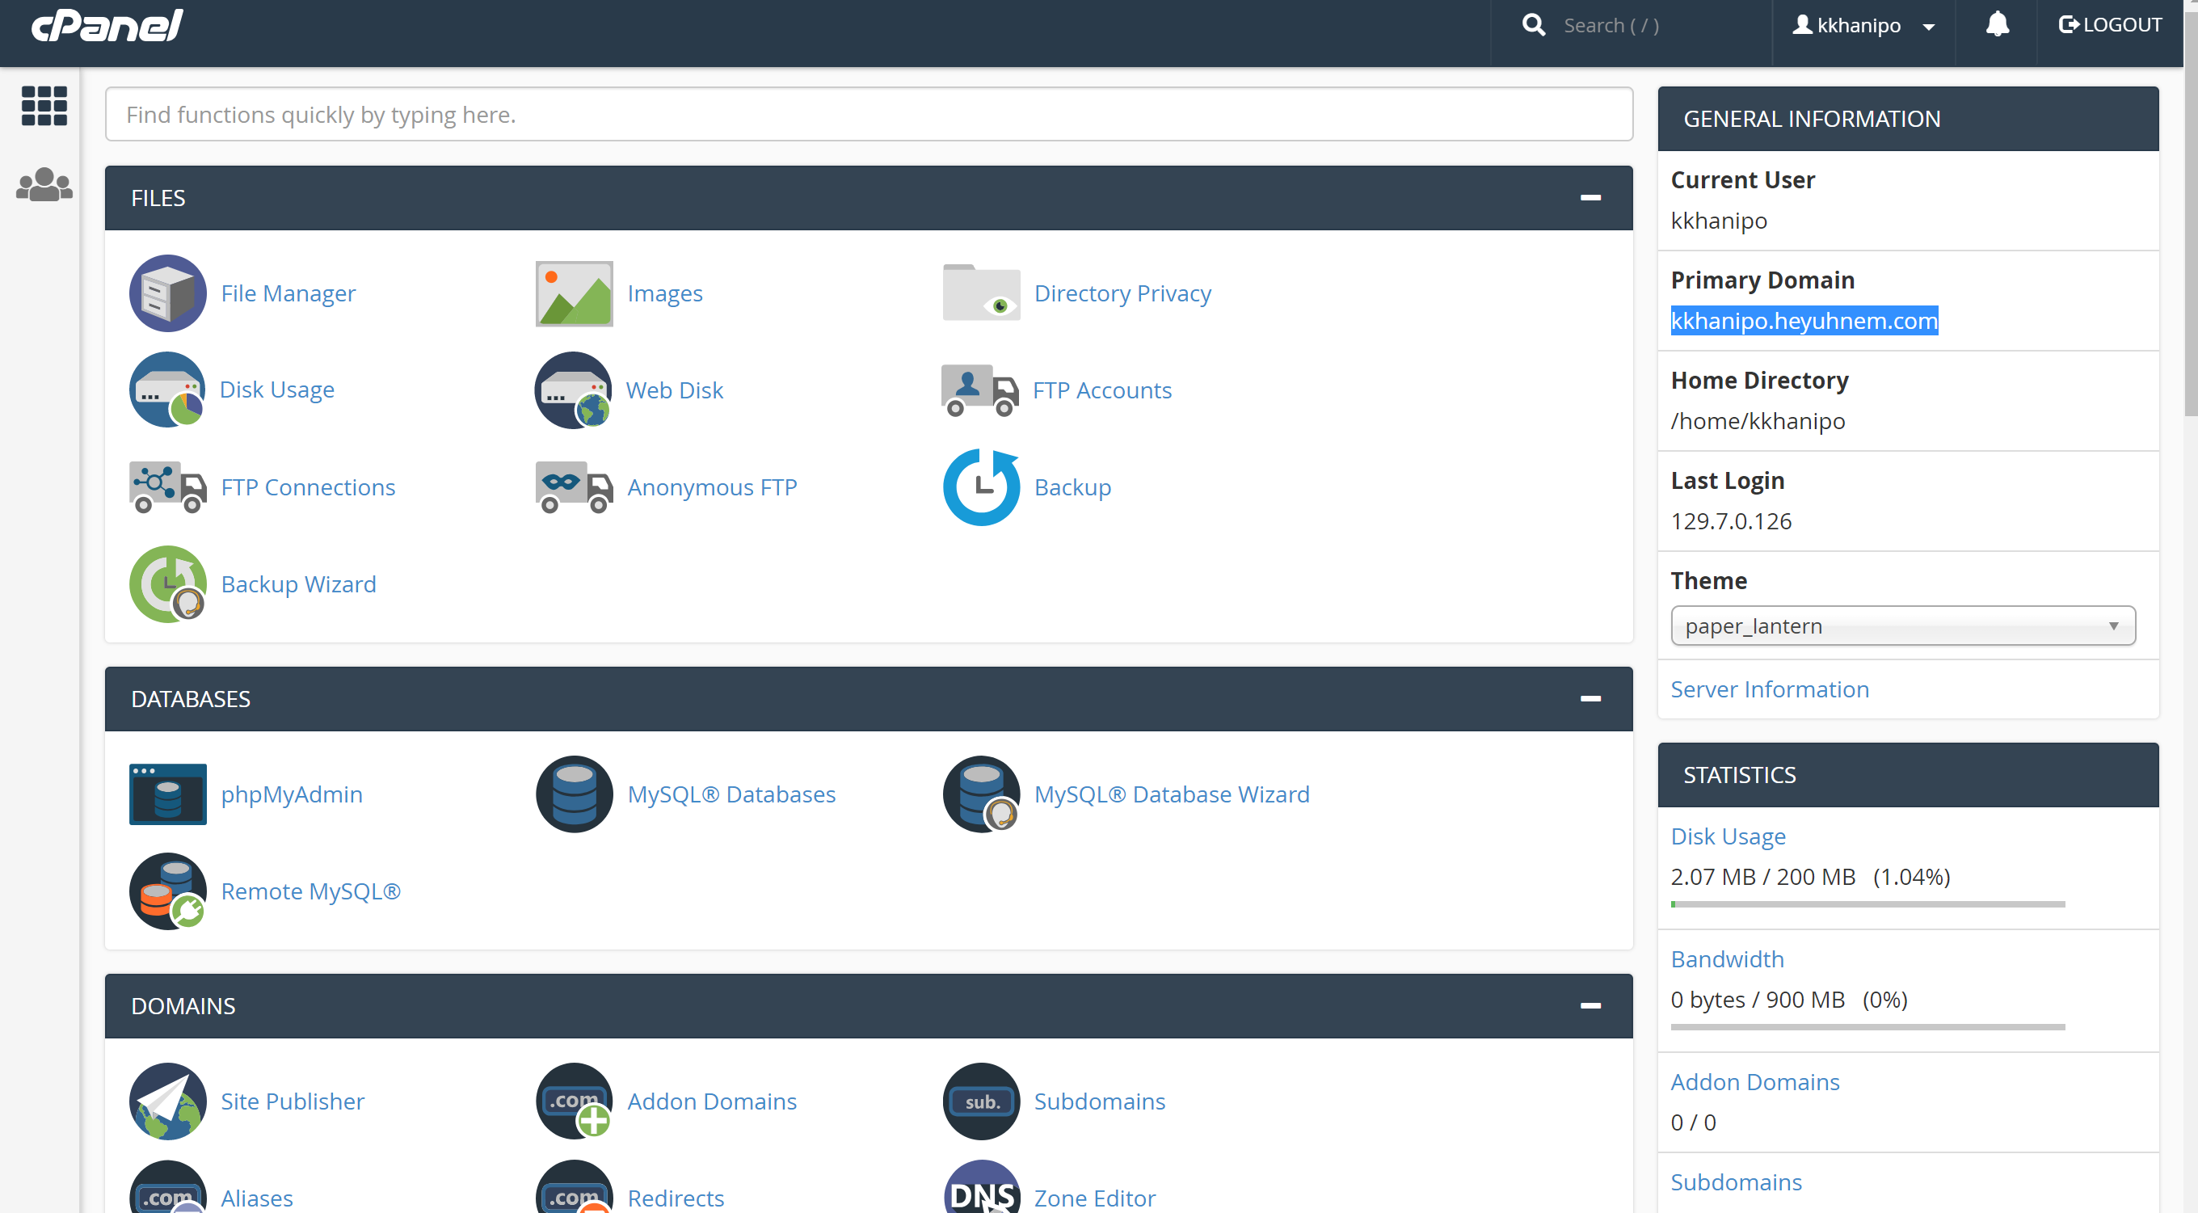
Things to go over
Changing Password
File Transfer
General Overview (theme, languages, etc)

Slide 4
Uploading your own index.html
<!doctype html>
<html>
<head>
<title>Your Name</title>
</head>
<body>
<h1>UH CIS2336!</h1>
<p>These are random words: Under Construction</p>
</body>
</html>

Slide 5
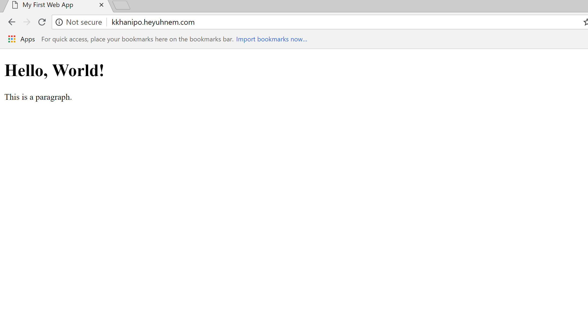

Slide 6
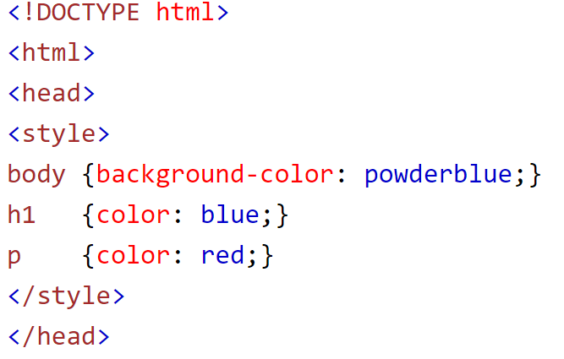
CSS – Cascading Style Sheets
CSS is a language that describes the style of an HTML document.
CSS describes how HTML elements should be displayed.
Inline - by using the style attribute in HTML elements
Internal - by using a <style> element in the <head> section
External - by using an external CSS file

Slide 7
Style your index.html
Index.html
style.css
<!doctype html>
<html>
<head>
<title>My First Web App</title>
<link href='style.css' rel='stylesheet' type='text/css'>
</head>
<body>
<h1>Under Construction</h1>
<p>This is a paragraph.</p>
</body>
</html>
body {
background: lightcyan;
width: 800px;
margin: auto;
}
h1 {
color: maroon;
text-align: center;
}
p {
color: gray;
border: 1px solid gray;
padding: 10px;
}

Slide 8
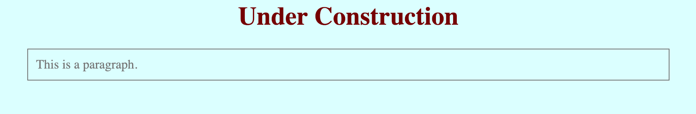

Slide 9
CSS – Rulesets
CSS represents a set of style rules that apply
Selector
Opening Curly Bracket
Property, followed by colon
Value, followed by semicolon
Closing Curly Bracket
body {
background: lightcyan;
width: 800px;
margin: auto;
}

Slide 10
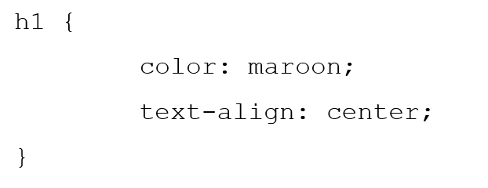
CSS – Selector
Basic Type selector

Slide 11
CSS Commenting
CSS also includes ability to comment
/* TEXT */
HTML comments <!–– TEXT ––>

Slide 12
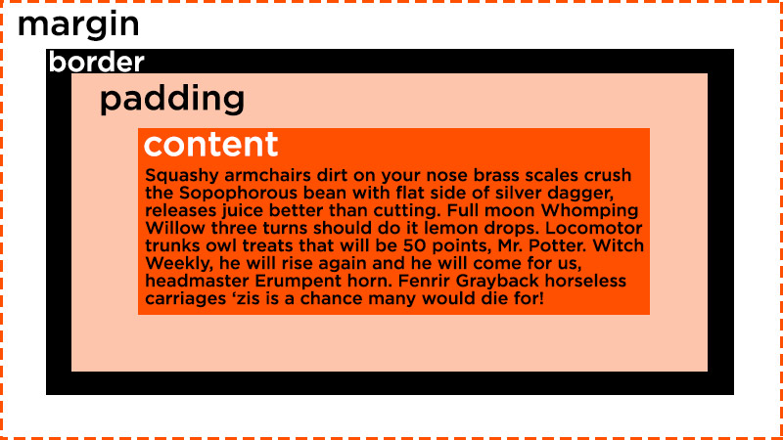
Block Style Elements (div, p, li, table, etc…)
Additional properties: Padding, Border, and Margin
Content - The content of the box, where text and images appear
Padding - Clears an area around the content. The padding is transparent
Border - A border that goes around the padding and content
Margin - Clears an area outside the border. The margin is transparent
Link

Slide 13
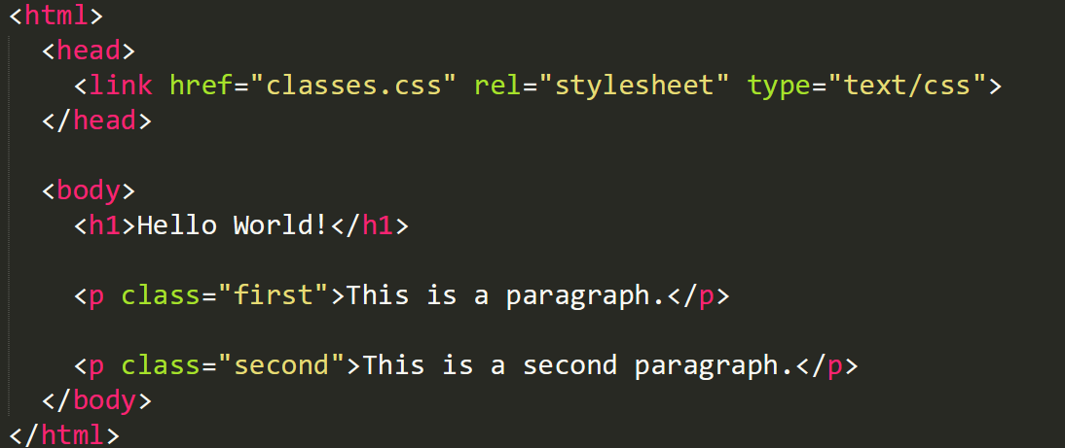
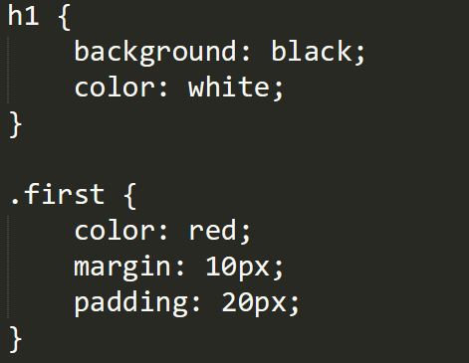
CSS – Selector based on Attributes (Classes, IDs)
HTML
CSS
Link

Slide 14
Inline vs Block Tags
HTML Tags to group together sections of HTML Code
SPAN
or
DIV
Great article:
https://www.lifewire.com/span-and-div-html-elements-3468185

Slide 15

CSS - Fonts

Slide 16
CSS – Applying Font
Include into CSS
Embed Font
To embed your selected fonts into a webpage, copy this code into the <head> of your HTML document
<link href="https://fonts.googleapis.com/css?family=Roboto" rel="stylesheet">
Specify in CSS
Use the following CSS rules to specify these families
font-family: 'Roboto', sans-serif;
link

Slide 17
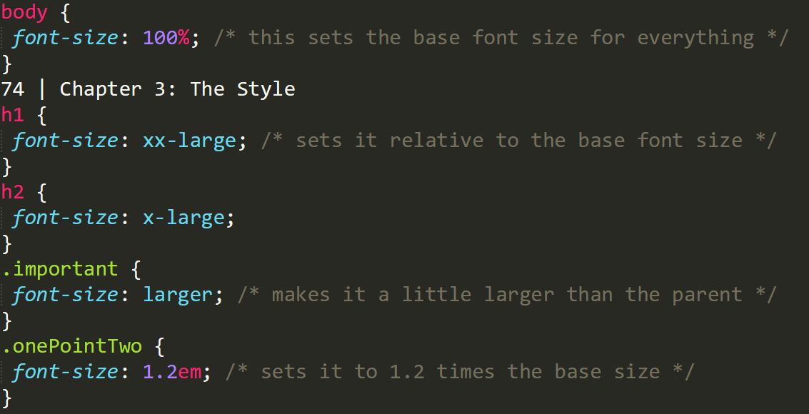
CSS – Font Size
link

Slide 18
Homework – Create an HTML and CSS Webpage
Requirements
Header Section
Table
Logo of UH with a link to uh.edu
Two lists (nested)
Footer Section
Style everything! Use a non-default font somewhere
Example given in worksheet

Slide 19
Class work
Create HTML and CSS

